Slide 1
Objects and loops

Slide 2
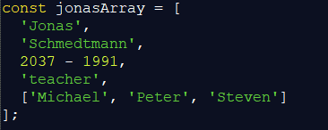
Objects
Data-type (data-structure) that is a bit more complex.
It contains many properties of different data-types
Let’s see how would an array look like:
Pay attention that we have something like a name, surname, age, job, and people related.

Slide 3
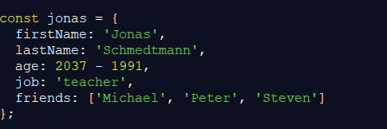
Objects
So why don’t we use arrays?
Well… First thing: arrays can add more elements, or remove existing ones
In Array we cannot guarantee that certain element represents certain property
But if we make an object – then we know exactly what is what:

Slide 4
Object
Let’s make an object:
Student
Name
Surname
Age
SchoolName
GamePlayer
Nickname
GameName
Ranking

Slide 5
Objects in C# and C++
Remember objects are created using a class.
In c# we would do something like:
worker Jonas = new worker(){
… set value for each property;
}
Here we would say Jonas is an object of class worker.
Similar situation is with C++, but in case of JS, we don’t need to make the class, we can create object directly without declaring class.

Slide 6

Objects and properties
Each object will have one or many properties.
Those properties could be accessed by using . notation:
So let’s see what happens if for object Jonas we do this:
Then see how to show certain property value:

Slide 7
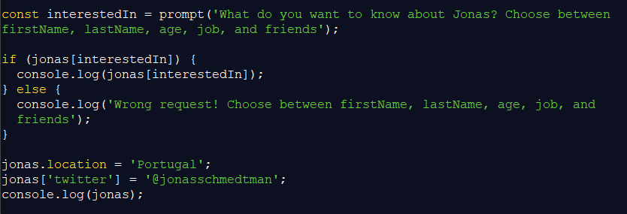
Objects
Now let’s see a simple example:

Slide 8
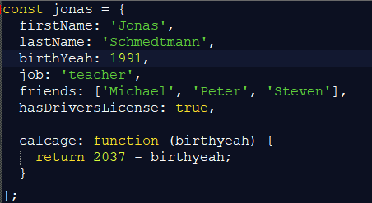
Functions in objects = methods
We can add the function inside of the object, and use it for that object
Something similar we have already seen in C# and C++

Slide 9
Calling the method
Remember how we would do this in C++ and C#, well it is very similar.
Now here we will call a method of Jonas object and show result in console
Problem here is each time we want to call this function, we need to provide it input parameter… so can we do something about it?
We can use THIS keyword to help us access this objects birthdate property

Slide 10
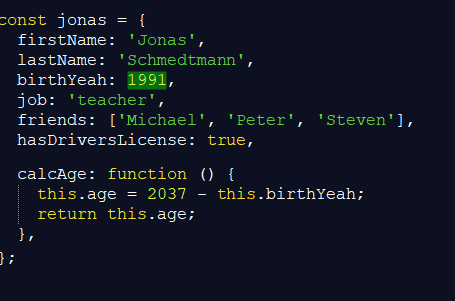
This keyword
In order to avoid input parameters when they are not needed, we can use THIS. So let’s change the method of the object.
Now we can call the method easily:

Slide 11
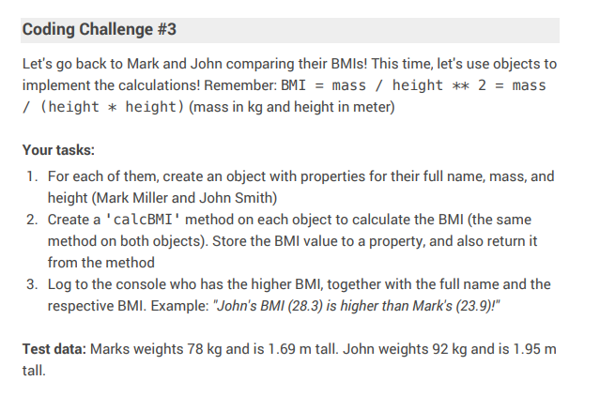
Coding challenge

Slide 12
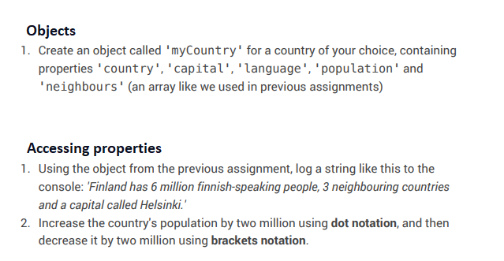
Homework 1

Slide 13
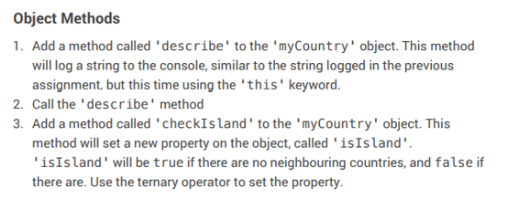
Homework 2

